Slide 1

Internship project:
Test automation
Amina Alijagić

Slide 2


Agenda
Demo 1 tasks
Importance of testing
Testing procedure
Test automation
Navigator.ba
Challenges
Next steps
Questions

Slide 3
Demo 1 tasks
“If someone offers you an amazing opportunity and you’re not sure you can do it, say yes - then learn how to do it later.” - Richard Branson
Install and setup environment
Get familiar with RSpec, Watir/Capybara and Selenium
Navigator.ba - exploratory testing
Write test plan for Navigator.ba
Create test cases for Navigator.ba
Based on exploratory testing write smoke test for Navigator.ba
Write regression tests for Navigator.ba
Write full bugs/improvements report
Push project to a GitHub repository
OS | Linux Ubuntu 16.04
Programming language | Ruby
Version control | Git Repository
Project management | Trello board

Slide 4
Importance of testing
Software that doesn’t work lead to many problems
Testing makes it possible to measure the quality of software in terms of defects found
Testing cannot prove the absence of defects, only that there are defects
Amount of testing must be prioritized based on risk (technical, safety and business risks) and project constraints (time, budget)
Communication between test team and development team is very important

Slide 5

Testing procedure
“Testing leads to failure, and failure leads to understanding. -Burt Rutan
Exploratory testing
Write a test plan
Create test cases
Write smoke test
Write regression test
Bug/Improvements report
Automated test script

Slide 6


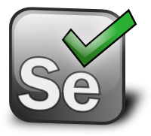


Introduction to test automation
Ruby as a script language
Rspec - DSL language for Ruby
Selenium
Watir - Web Application Testing In Ruby
Capybara
Demo (Facebook login example)

Slide 7

Navigator.ba
Web and mobile application
Provides information on locations of streets and objects in Bosnia and Herzegovina (with focus on Sarajevo)
Possible to add new locations or update existing information provided in the application.
Intuitive and simple to use.
Intended to be the most popular city guide with a rich database that is constantly updated.

Slide 8
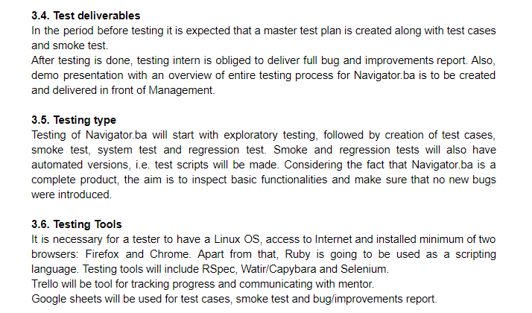
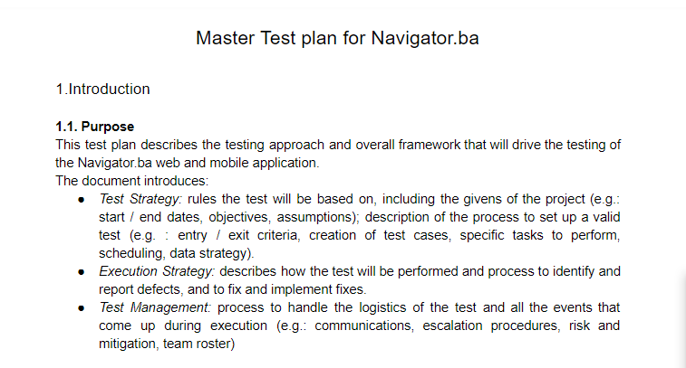
Test plan for Navigator.ba

Slide 9
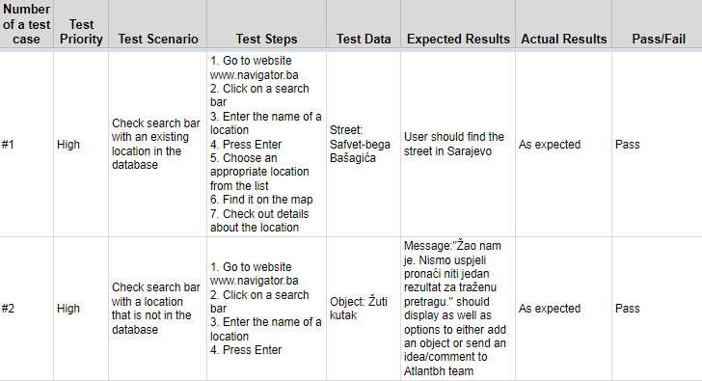
Test cases
35 test cases, 31 pass, 4 fail

Slide 10
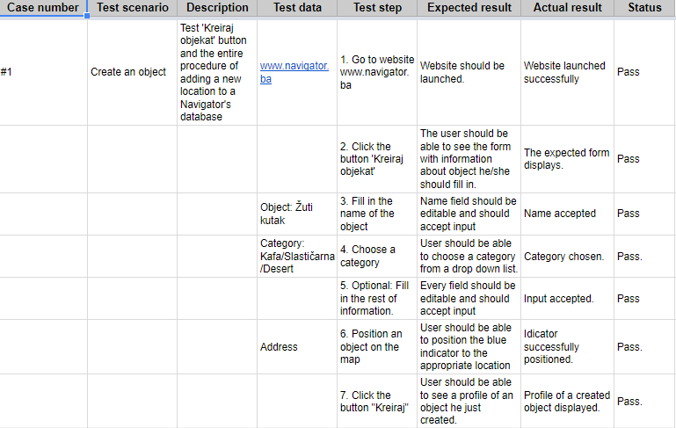
Smoke and Regression test

Slide 11
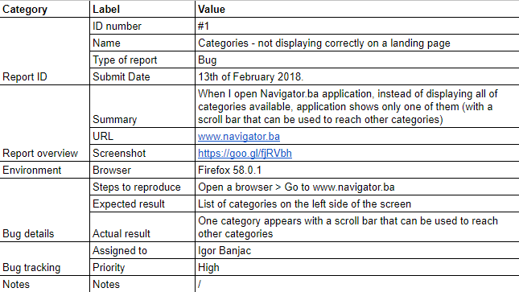
Bugs and Improvements Report

Slide 12

Test automation script for smoke test

Slide 13
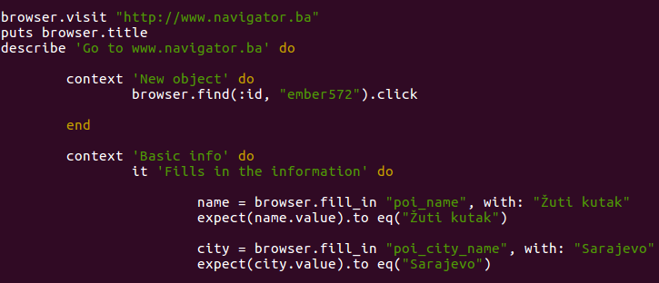
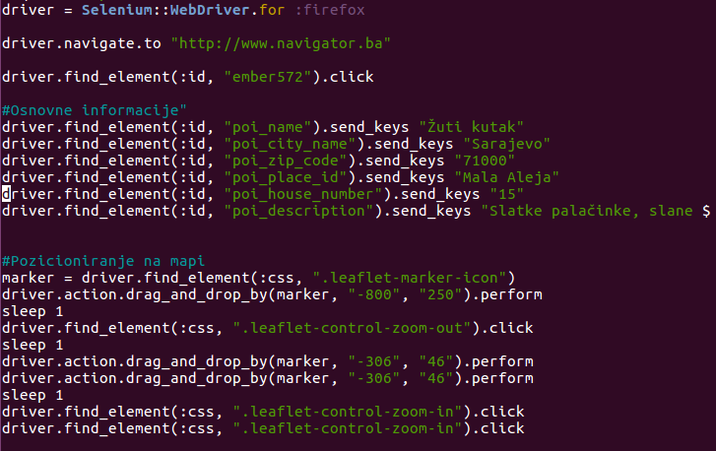
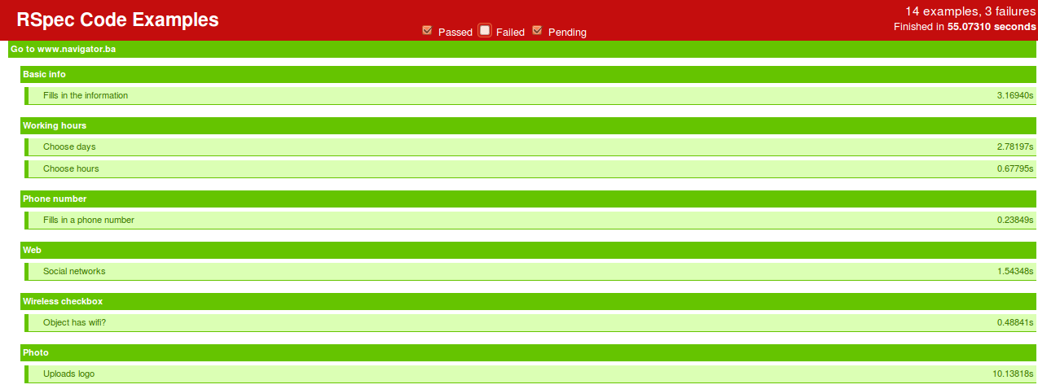
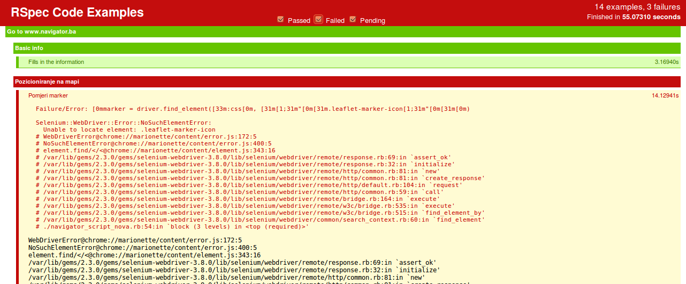
Test automation script for smoke test - code

Slide 14

Challenges
Setting up environment
External factors
Combining test tools
Resources

Slide 15
Next steps
Complete test automation script for smoke test
Finish Udemy course
Create test automation script for regression test
Add improvements to report
Refactoring
Demo 2 tasks

Slide 16


